Slide 1


Group 2: Resort Reservation
Victoria Elaine
Gavin Kyle Torres
Valencia Jamil
Estimadora Jhon Texter
Prof: Elizer Jr. Ponio

Slide 2
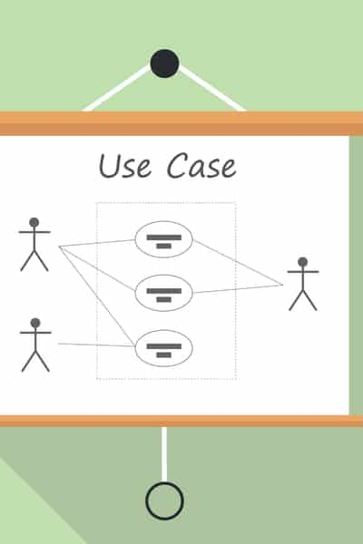
Introduction of the use case application
The case application we chose is resort reservation so this is what we chose because sometimes these are the requirements of each resort to better organize and improve the system or flow of their resort here we show that it will be easier for people to book and not be chaotic. In short A guest who makes a reservation in advance will have a guarantee that the rooms he requested at the time of booking, such as the number of rooms for his entire stay, will be available when he arrives.

Slide 3
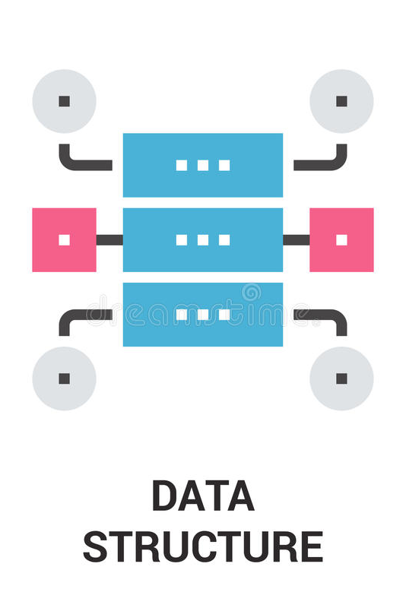
The chosen data structure used in detail
A queue is a linear data structure that acts as a collection of elements and has three primary operations: enqueue, dequeue, and peek.
Linked List is a part of the Collection framework present in java.util package. This class is an implementation of the LinkedList data structure which is a linear data structure where the elements are not stored in contiguous locations and every element is a separate object with a data part and address part.

Slide 4
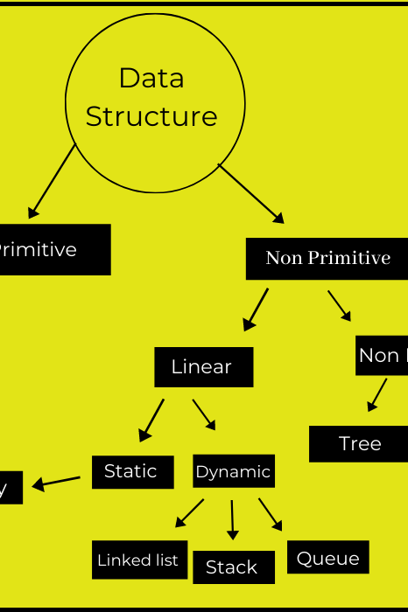
Why was the data structure chosen?
The Java Queue interface supports all Collection interface methods, including deletion, insertion, and linked lists that can grow in size dynamically. Unlike arrays, it is simple to insert and delete elements from a linked list because we only need to change the pointers of the previous and next element to insert or delete an element.

Slide 5

BENEFITS OF THE DATA STRUCTURE ON THE CASE APPLICATION
To reduce customer wait time and service time
To reduce customer complaint
More organized costumer service
Gives you access to the customer data

